Slide 1
Data Profiling in ETL
and
SCD Types

Slide 2

Agenda
Data Profiling
Overview of Data Profiling
Null/Empty Value checks
Summary of Numeric columns
Distinct values for columns of Interest
Distribution for Aggregate Columns
Data Quality Mismatch Percentage
Slowly Changing Dimensions(SCD)
SCD Type1
SCD Type2
SCD Type3

Slide 3
Data Profiling
What is Data Profiling in ETL?
Data Profiling in ETL is a detailed analysis of source data. It tries to understand the structure, quality and content of source data and its relationships with other data.
It takes place during the Extract, Transform and Load (ETL) process and helps organizations find the right data for projects.

Slide 4
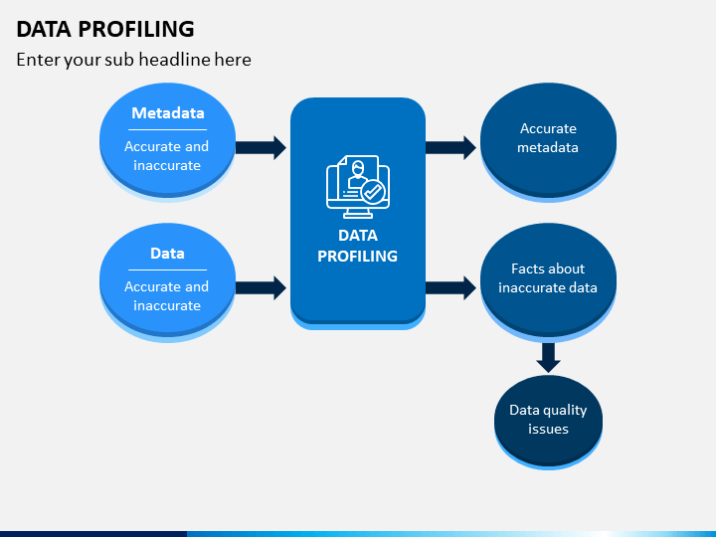
Data Profiling

Slide 5
Organizations use data profiling in ETL in the following scenarios:
A requirement to automate the data profiling process.
Reducing human errors during data profiling.
The need for high-quality and consistent data.
Identifying problems during data profiling.
When data profiling in ETL, organizations discover whether data is:
Unique
Incomplete
Corrupted
Duplicated

Slide 6
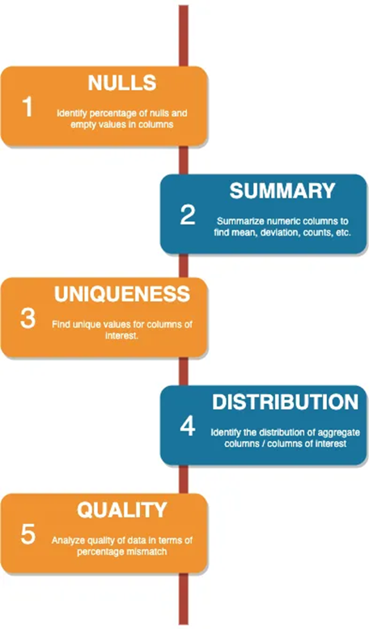
Process Flow

Slide 7
Sample example
Overview
The objective of this utility is to provide a pluggable solution in PySpark to easily profile your data while measuring its quality.
Source Code
The entire source code for the above implementation is available at
GitHub: https://github.com/hari328373/data_profiling

Slide 8
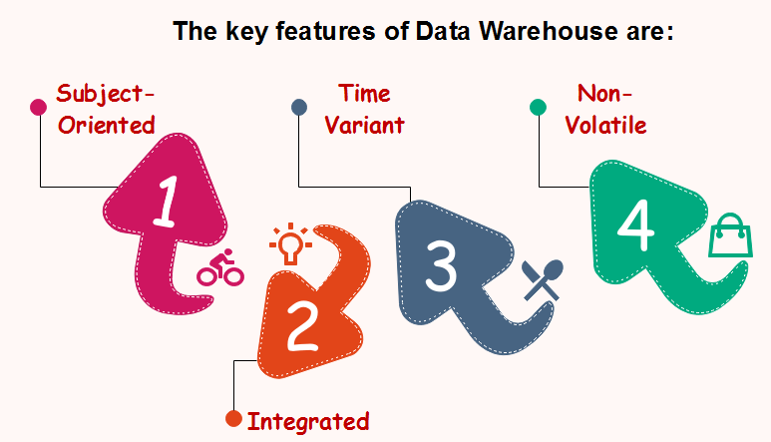
Data Warehouse
A data warehouse is a centralized storage system that allows for the storing, analyzing, and interpreting of data in order to facilitate better decision-making.

Slide 9
OLTP
OLTP stands for Online Transactional Processing
It contains recent data
Mostly updates
Read or write operations
Response in milliseconds
Less maintenance on comparison with OLAP
More normalized

Slide 10
OLAP
OLAP stands for Online Analytical Processing
It holds historical data
OLAP contains filtered and clean data
Row or columnar database
Mostly reads

Slide 11
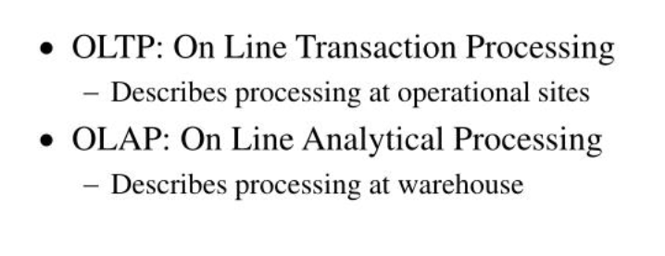
OLTP vs OLAP

Slide 12
Slowly changing Dimension
Slowly Changing Dimensions (SCD) - dimensions that change slowly over time, rather than changing on regular schedule, time-base.
In Data Warehouse there is a need to track changes in dimension attributes in order to report historical data.
In other words, implementing one of the SCD types should enable users assigning proper dimension's attribute value for given date.

Slide 13
SCD Type 1
Incremental updates
Current data
Upsert method
Do not capture any History
Exists records will updated
New record will inserts
Existing data
Employee_ID | Name | Department | Address
E001 | Roshan | Sales | Hyderabad
E002 | Sai | Marketing | Hyderabad
E003 | Bhanu | Sales | Kolkata
E004 | Chaitu | Full-stack | Bangalore

Slide 14
New Data1:
Here Employee Id is same so it will update the records i.e., Address of E003 and E004 will update to Hyderabad.
Output1:
Employee_ID | Name | Department | Address
E003 | Bhanu | Sales | Hyderabad
E004 | Chaitu | Full-stack | Hyderabad
Employee_ID | Name | Department | Address
E001 | Roshan | Sales | Hyderabad
E002 | Sai | Marketing | Hyderabad
E003 | Bhanu | Sales | Hyderabad
E004 | Chaitu | Full-stack | Hyderabad

Slide 15
New data2:
Here Employee Id is different so it will insert these two Ids as new records.
Final Output:
Employee_ID | Name | Department | Address
E005 | Aparanji | Data Engineer | Hyderabad
E006 | Pravi | Data Engineer | Hyderabad
Employee_ID | Name | Department | Address
E001 | Roshan | Sales | Hyderabad
E002 | Sai | Marketing | Hyderabad
E003 | Bhanu | Sales | Hyderabad
E004 | Chaitu | Full-stack | Hyderabad
E005 | Aparanji | Data Engineer | Hyderabad
E006 | Pravi | Data Engineer | Hyderabad

Slide 16
SCD Type 2
It maintains all historical records along with current records
It is use for change data capture (CDC)
Table sizes increases usually with Time
Here we need to know about ESD, EED, Active Flag
ESD ( Effective Start Data) : when we are upload the records
EED ( Effective End Date): when that record is expiring if the record is the current record we usually use a high Date ( 31st December 9999)
Active Flag : if the record is a current then it is 1 or Y.
if the record is expired or historical record is 0 or N.

Slide 17
Existing Data:
New Data on 10-Jan-2023
Here, Address of Employee_ID (E001) is change so, EED is change to upload date and Active Flag is N.
Employee_ID | Address | ESD | EED | Active Flag
E001 | Bangalore | 1-Jan-2023 | 31-Dec-9999 | Y
E002 | Kolkata | 1-Jan-2023 | 31-Dec-9999 | Y
E003 | Hyderabad | 1-Jan-2023 | 31-Dec-9999 | Y
Employee_ID | Address
E001 | Hyderabad

Slide 18
Final Output:
Employee_ID | Address | ESD | EED | Active Flag
E001 | Bangalore | 1-Jan-2023 | 10-Jan-2023 | N
E002 | Kolkata | 1-Jan-2023 | 31-Dec-9999 | Y
E003 | Hyderabad | 1-Jan-2023 | 31-Dec-9999 | Y
E001 | Hyderabad | 10-Jan-2023 | 31-Dec-9999 | Y
Historical data
Current data

Slide 19
SCD Type 3
It only contains current change and last historical data.
It is generally maintained in either row or column format
Existing Data:
New Data1:
Employee_ID | Current_Address | Past_Address
E001 | Kolkata | Null
E002 | Bangalore | Null
Employee_ID | Current_Address
E001 | Hyderabad

Slide 20
Output1:
New Data2:
Final Output:
Employee_ID | Current_Address | Past_Address
E001 | Hyderabad | Kolkata
E002 | Bangalore | Null
Employee_ID | Current_Address
E001 | Bangalore
Employee_ID | Current_Address | Past_Address
E001 | Bangalore | Hyderabad
E002 | Bangalore | Null

Slide 21

Presented by
M. Haritha Sumanjali
Jr. Data Engineer

